Slide 1


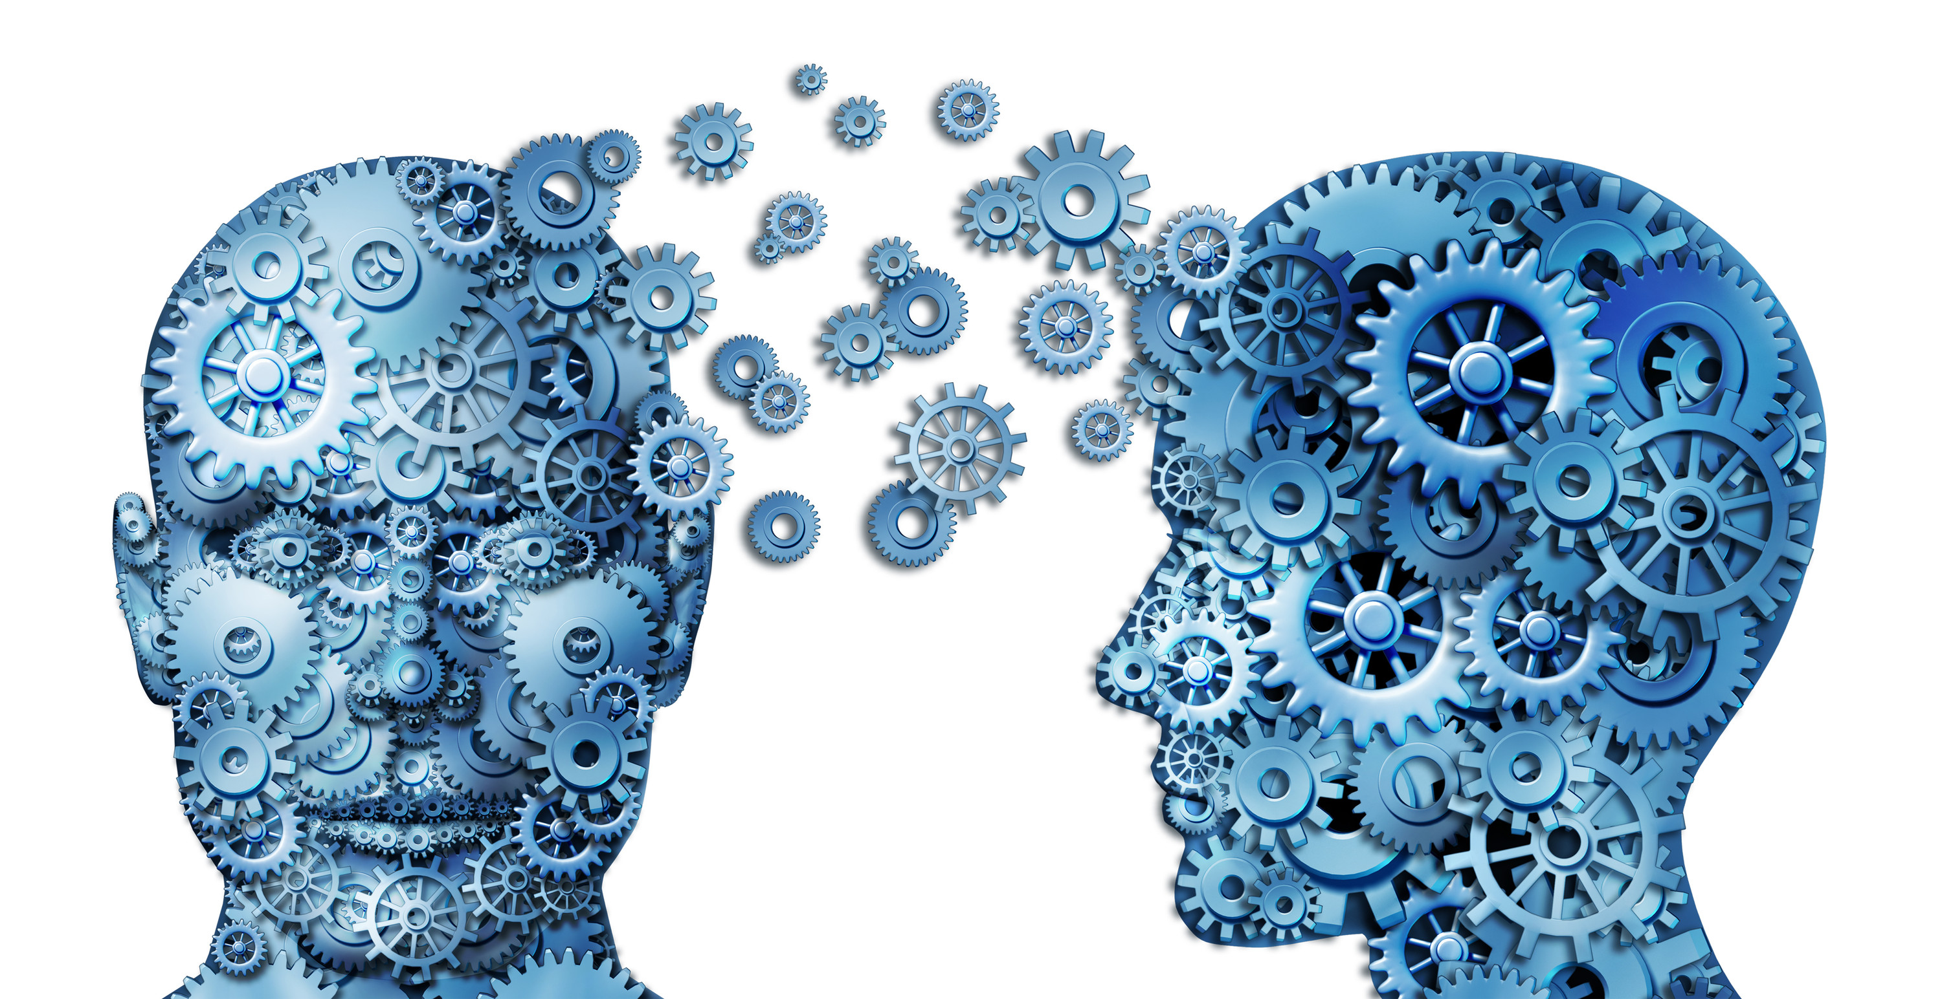
Final Year Project Advanced Video Analytics Using Deep Convolutional Neural Networks Presented By : Amine Ben Ali
Iobird’s Advisors :
Salem Mosbah,
PhD, Iobird CTO
Enetcom’s Advisor:
Bassem Ben Hamed,
PhD, University of Sfax

Slide 2
Plan
1
Deep Learning Tool
4
Implementation
5
Use Cases
2
Introduction
6
Conclusion
FaceNet
3

Slide 3
1
Deep Learning Tool
4
Implementation
5
Use Cases
2
Introduction
6
Conclusion
FaceNet
3

Slide 4
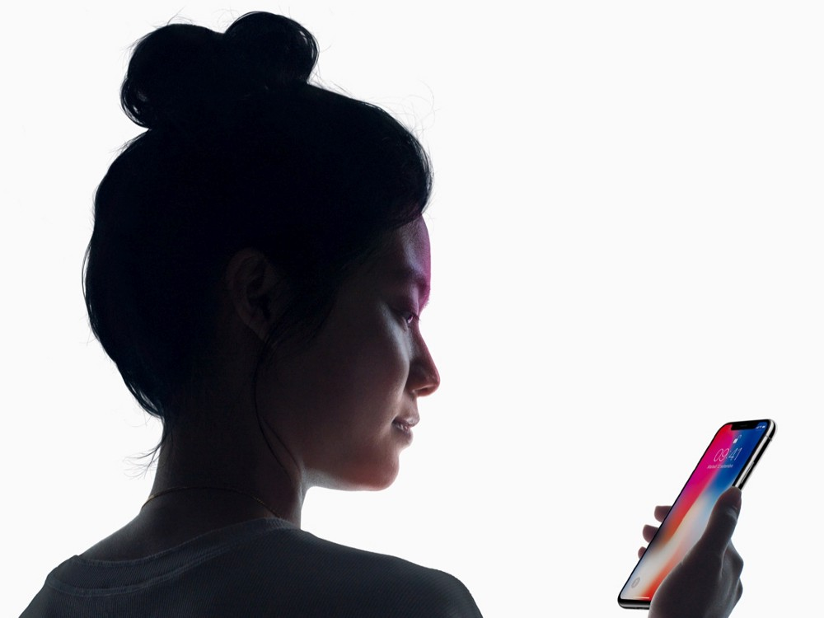
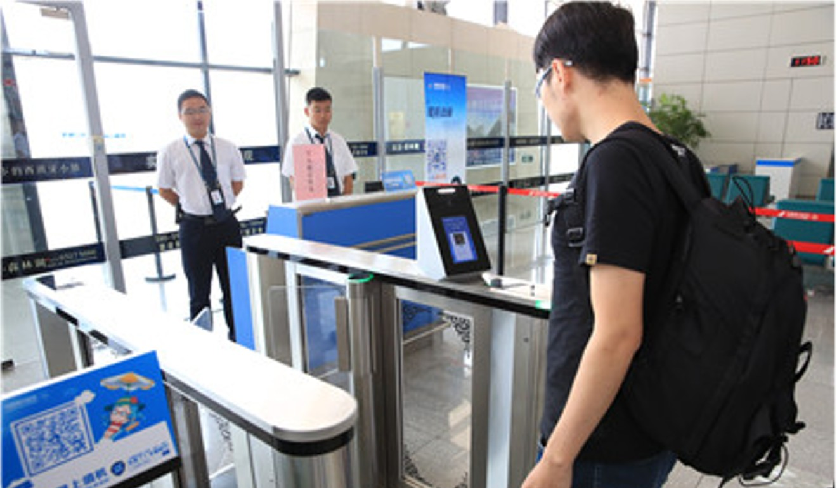
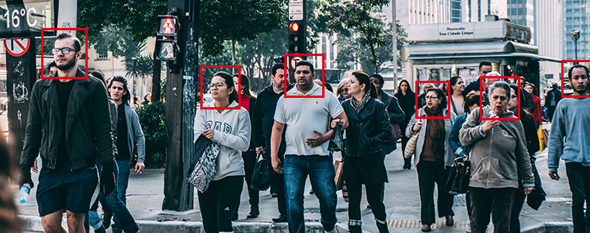
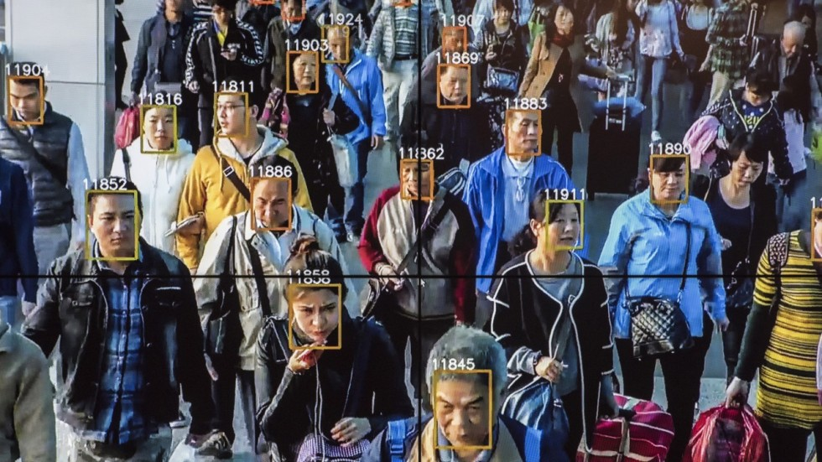
Computer Vision : Face Recognition
Introduction

Slide 5
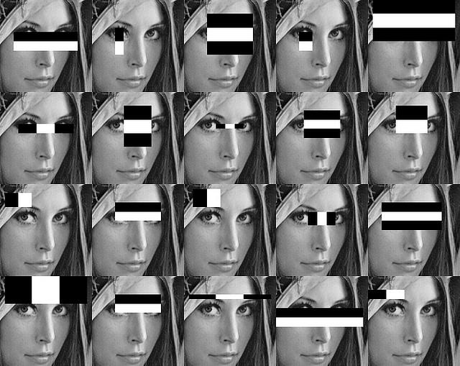
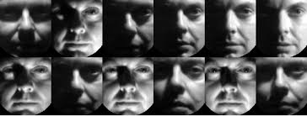
Problematic case : Classical Face Recognition
Introduction
Features -> handpicked
Fails on illumination variations and facial expressions
Fails on large datasets

Slide 6
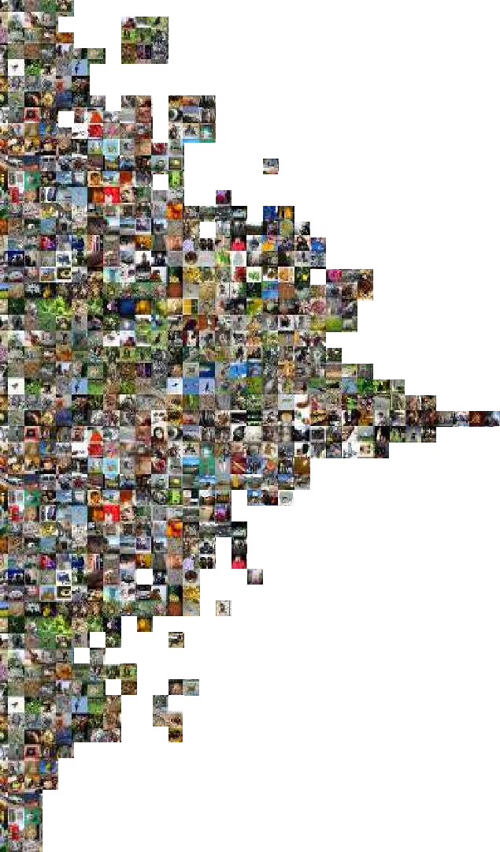
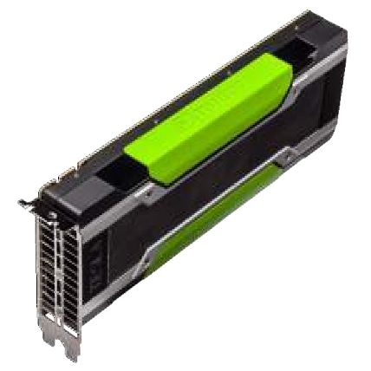
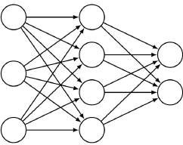

Solution : Deep Learning
Introduction
Reasons For Success :

Slide 7
1
Deep Learning Tool
4
Implementation
5
Use Cases
2
Introduction
6
Conclusion
FaceNet
3

Slide 8
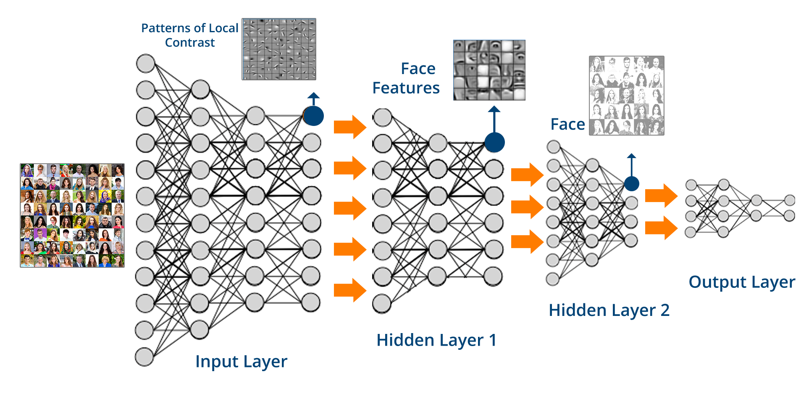
Deep Convolutional Neural Networks
Deep Learning Tool
What are Convolutional Neural Networks ?
One of the most powerful machine learning tools for image processing tasks
Concerted in a way to mimic the function of the visual cortex of the human brain
Building Blocks of The ConvNets:
There are four main operations:
Convolution Layer
Pooling Layer
ReLU Layer
Fully Connected Layer

Slide 9
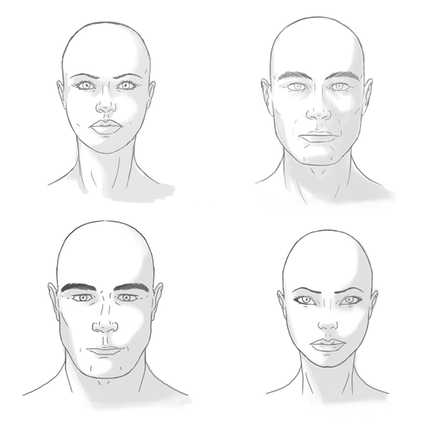
Deep Convolutional Neural Networks
Deep Learning Tool
The Network will find the features itself …

Slide 10
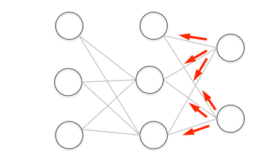
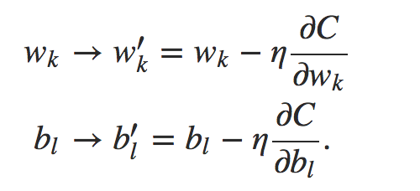
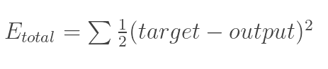
Deep Convolutional Neural Networks
Deep Learning Tool
The Backpropagation :
Loss function : usually it is the
Mean Squared Error (MSE)
Updating the weights

Slide 11

Tensorflow
Deep Learning Tool
Google !
Open Source
Standard Software for general machine learning
Great for Deep Learning in particular
First released Nov 2015
Version 1.8 released
Apache 2.0 license

Slide 12
1
Deep Learning Tool
4
Implementation
5
Use Cases
2
Introduction
6
Conclusion
FaceNet
3

Slide 13
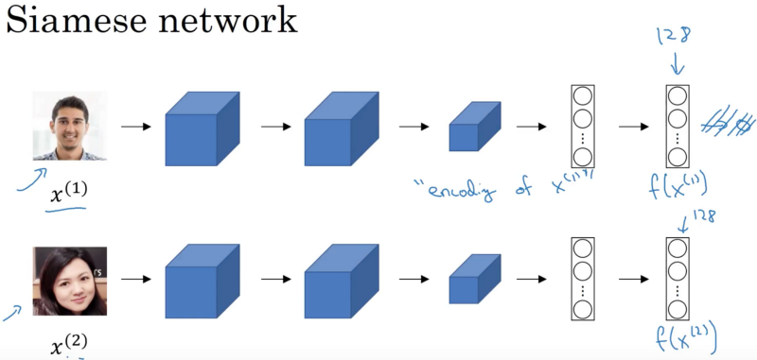
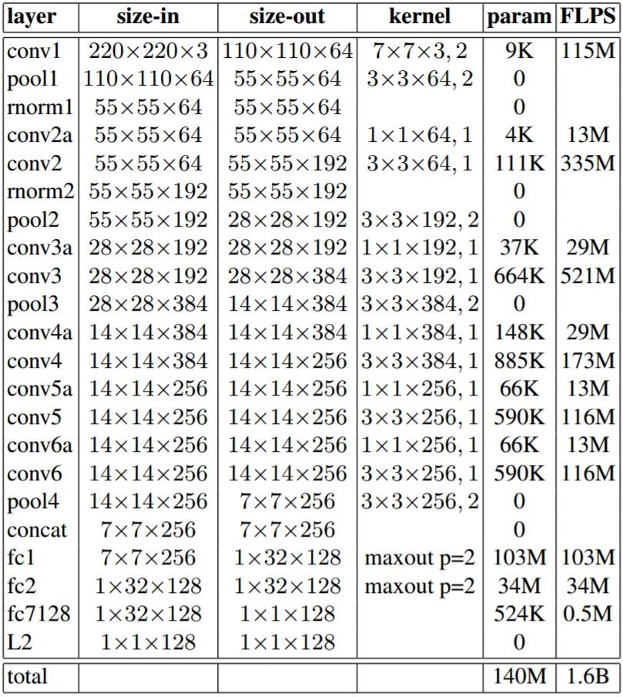
FaceNet
FaceNet
Training set : CASIA-Webface (consists of 500K images over 10K identities)

Slide 14
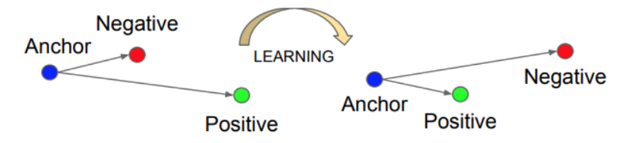
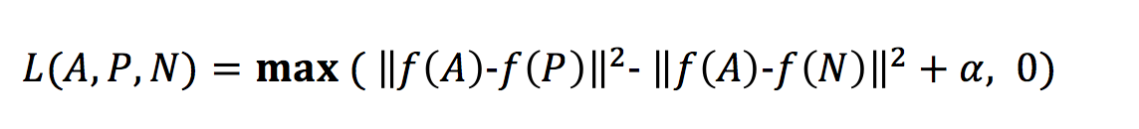
Training : Triplet Loss Function
FaceNet

Slide 15
1
Deep Learning Tool
4
Implementation
5
Use Cases
2
Introduction
6
Conclusion
FaceNet
3

Slide 16


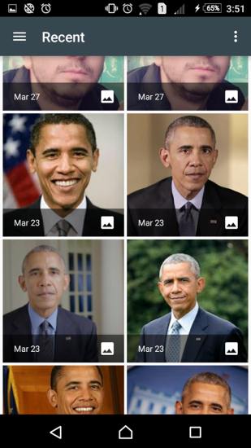
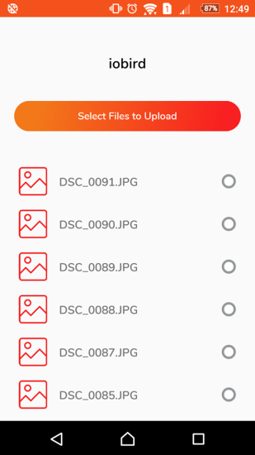


Implementation
Implementation
1. Collect the images of individuals we want to identify

Slide 17


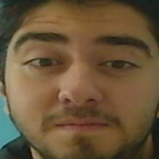
Implementation
Implementation
2. Align and crop the faces using MTCNN (Multi-task Cascaded Convolutional Neural Networks)

Slide 18
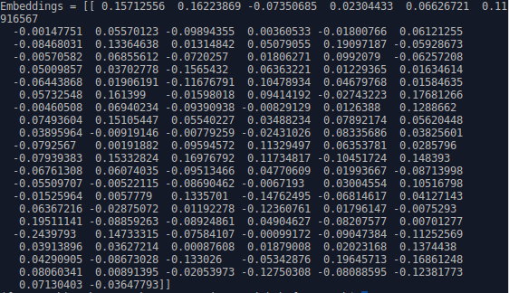


Implementation
Implementation
3. Use the pre-trained FaceNet model to generate 128 measurements for each face and then store them with respective persons names on disc.

Slide 19

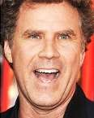




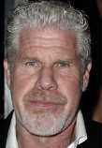
Implementation
Implementation
4. Map the embeddings to a compact Euclidean space and train an SVM classifier that can take in the measurements from a new test image and tells which known person is the closest match.
It’s Amine
?
?
?

Slide 20
1
Deep Learning Tool
4
Implementation
5
Use Cases
2
Introduction
6
Conclusion
FaceNet
3

Slide 21
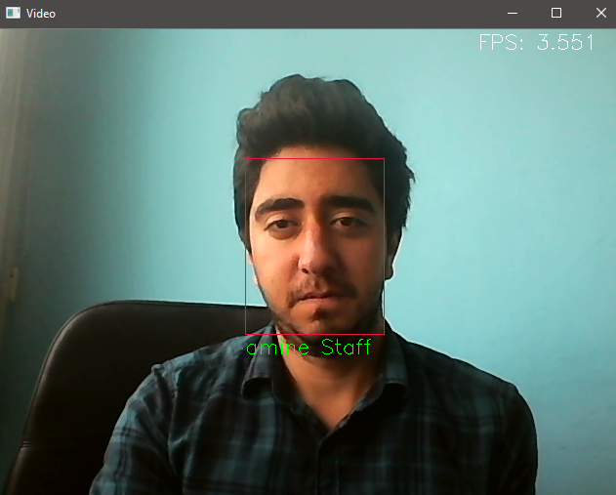
Security
Use Cases
Unknown People Recognition
Employees Recognition
Time and Attendance at work
Shoplifters Recognition (in retail)

Slide 22

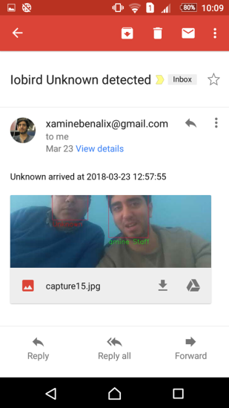
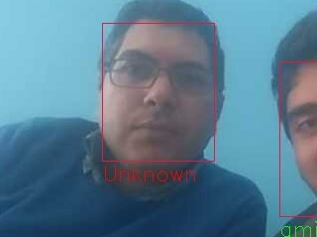
Security
Use Cases

Slide 23
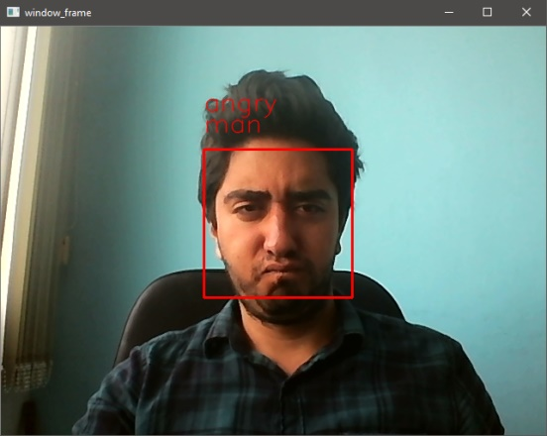
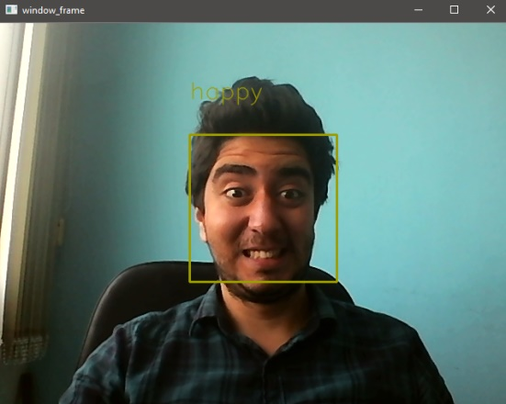
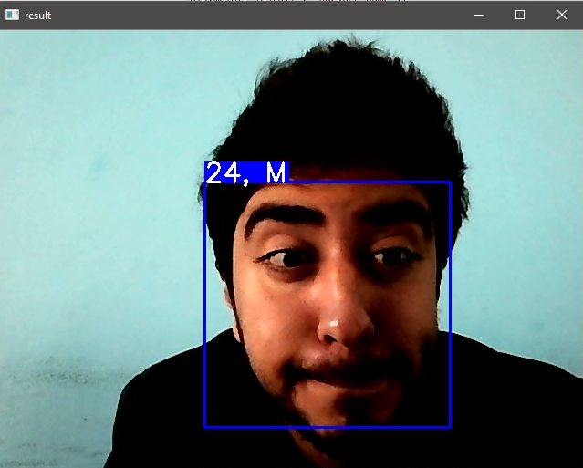
Marketing
Use Cases
Emotion Analysis
Age Analysis
Gender Analysis
Loyal Customers Recognition
Notes:
Automatic human age, gender and emotion classiﬁcation ﬁnds many real world applications such as target advertisement, demographics analysis and visual surveillance.

Slide 24
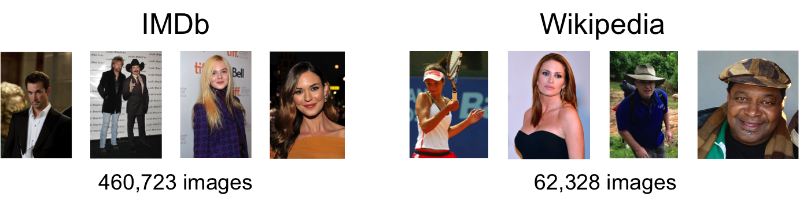
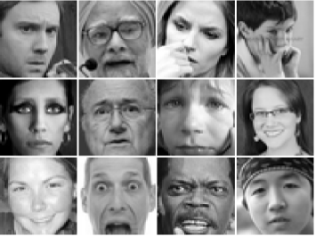
Marketing
Use Cases
Training set : IMDb-Wiki
With gender and ages labels
Training set : Fer2013
(7 Emotions: Angry, Disgust, Fear,
Happy, Sad, Surprise, Neutral)
30K images
Notes:
We just need to provide labeled datasets to Deep convolutional neural networks and with its special Back-propagation algorithm, it is able to extract features without human direction.
For Age and gender analysis, we used The IMDb-WIKI${}^{[11]}$ dataset which is the largest publicly available dataset of face images with gender and age labels
For Emotion Analysis, we used the fer2013${}^{[12]}$ dataset which consists of 28,709 48x48 pixel gray scale images of faces.
Each face is categorized based on the emotion shown in the facial expression in to one of seven categories (0=Angry, 1=Disgust, 2=Fear, 3=Happy, 4=Sad, 5=Surprise, 6=Neutral).

Slide 25
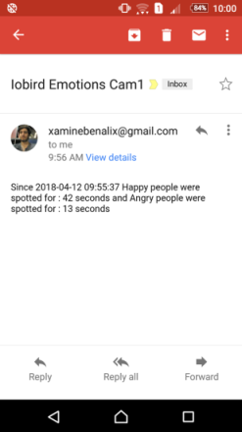
Marketing
Use Cases

Slide 26
1
Deep Learning Tool
4
Implementation
5
Use Cases
2
Introduction
6
Conclusion
FaceNet
3

Slide 27
Conclusion
Conclusion
Deep CNN-based method for face recognition and analysis
State of the art face recognition with more than 99% accuracy
Using only 128 bytes per face
No privacy concerns

Slide 28
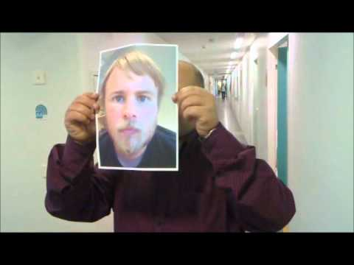
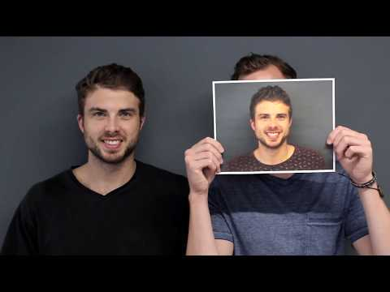
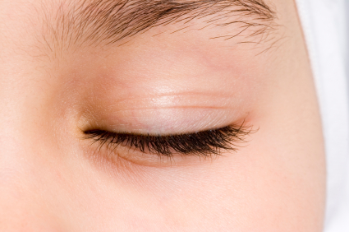
Future Work
Conclusion
Adding Liveness Detection
Eye-blink model as an anti-spoofing approach

Slide 29
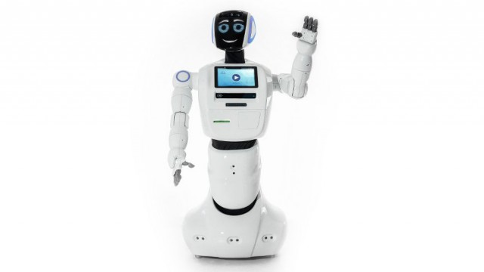
Thank You!

